Slide 1
TinyML
Reading:
BENCHMARKING TINY ML SYSTEMS : CHALLENGES AND DIRECTION Colby R. Banbury
ChamNet: Towards Efficient Network Design through Platform-Aware Model
Adaptation
Xiaoliang Dai
Measuring what Really Matters: Optimizing Neural Networks for TinyML
Lennart Heim
Neural Architecture Search Survey: A Hardware Perspective
KRISHNA TEJA CHITTY-VENKATA
MnasNet: Platform-Aware Neural Architecture Search for Mobile
Mingxing Tan
TENSOR FLOW LITE MICRO :
EMBEDDED MACHINE LEARNING ON TINY ML SYSTEMS
Robert David
TinyML Benchmark: Executing Fully Connected Neural Networks on Commodity Microcontrollers
Bharath Sudharsan
TinyML Meets IoT: A Comprehensive Survey
Dr. Lachit Dutta
TinyML Benchmark: Executing Fully Connected
Neural Networks on Commodity Microcontrollers
Bharath Sudharsan

Slide 2
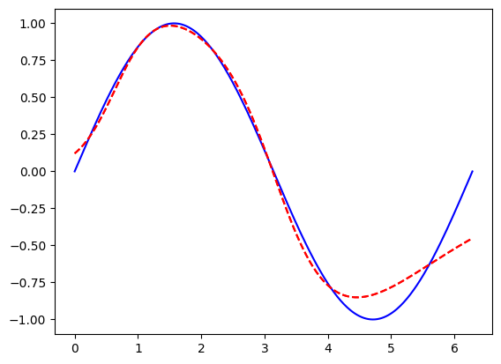
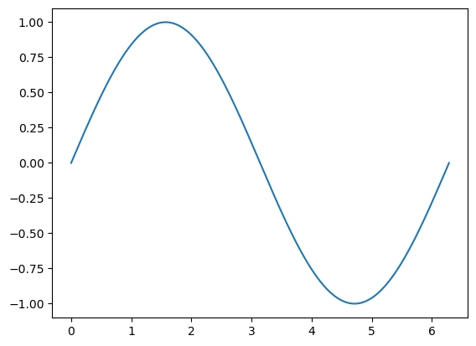
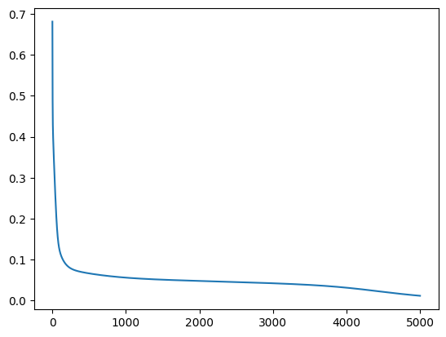
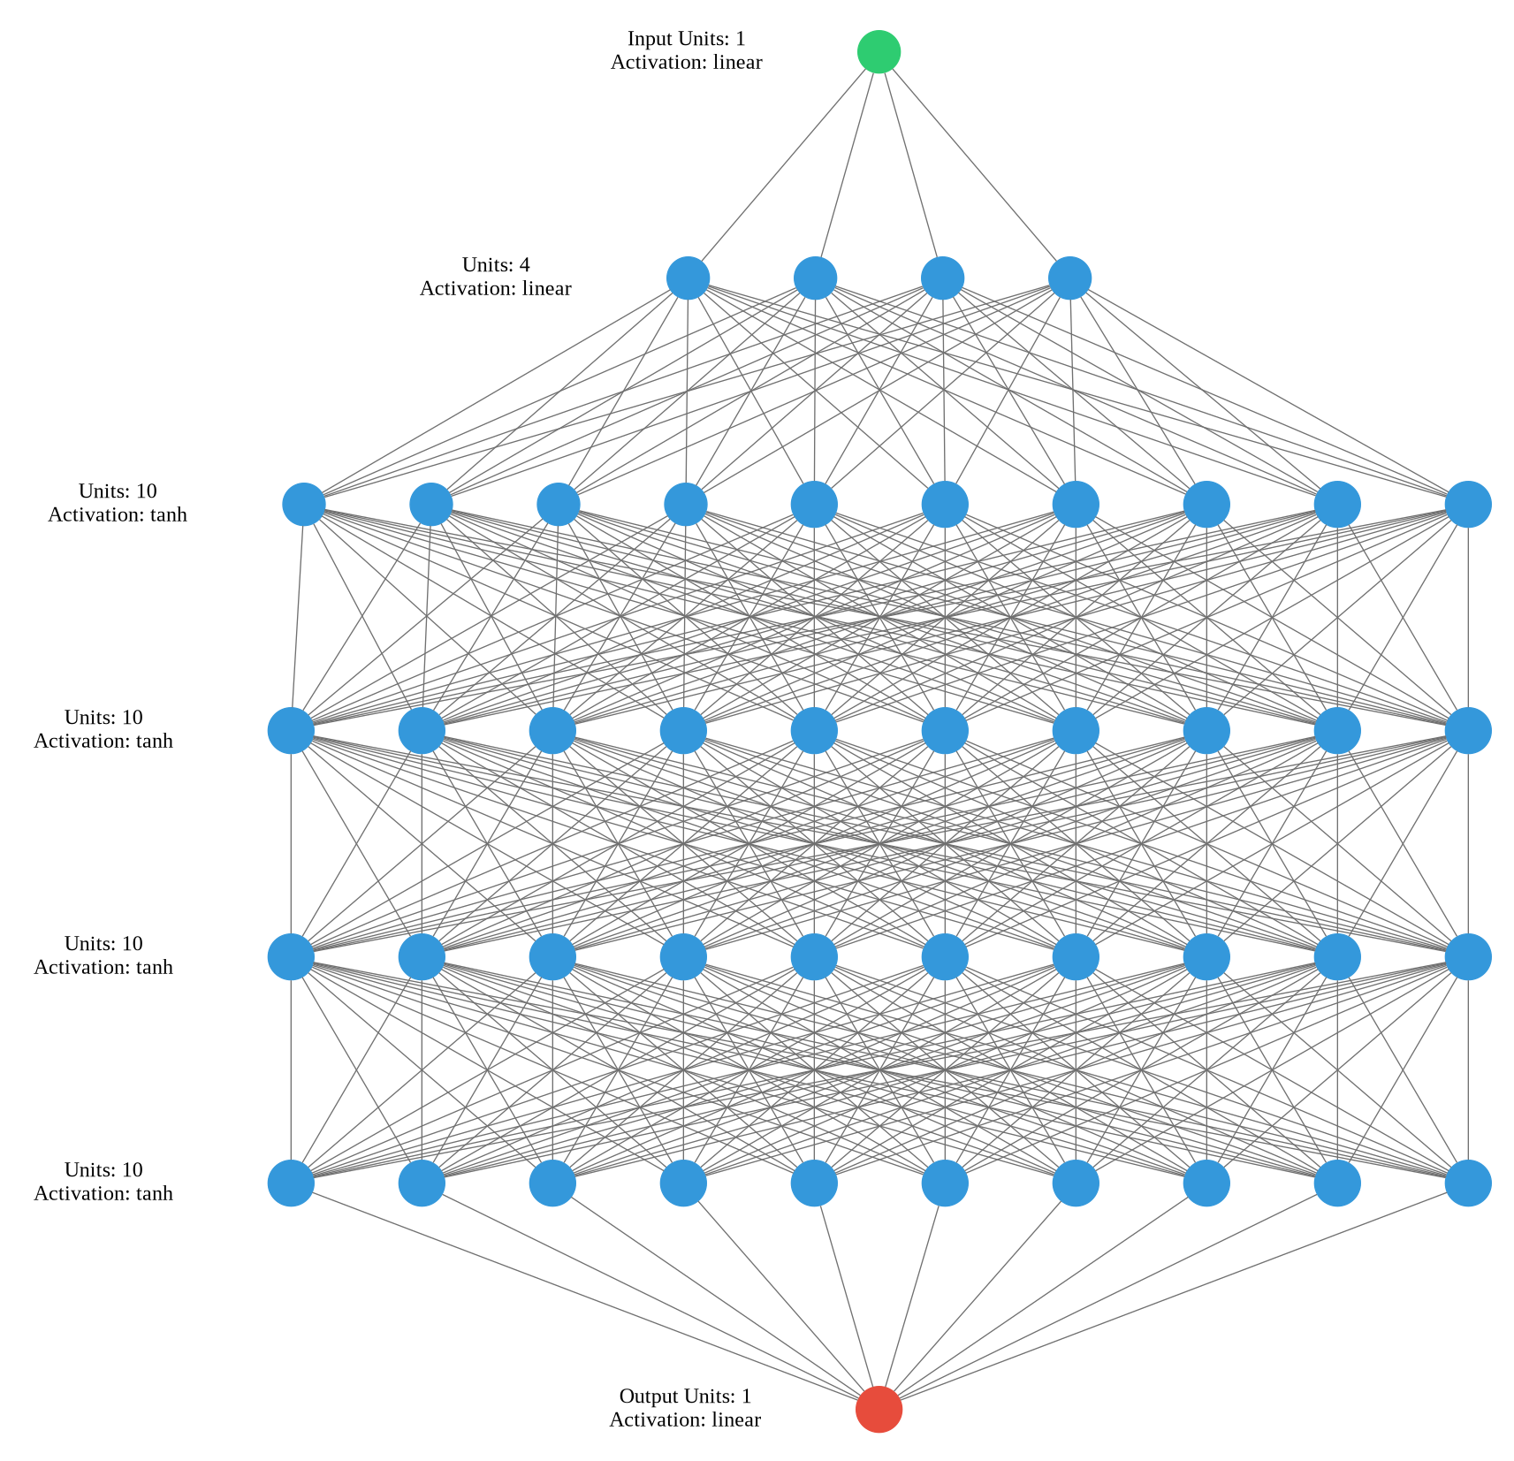
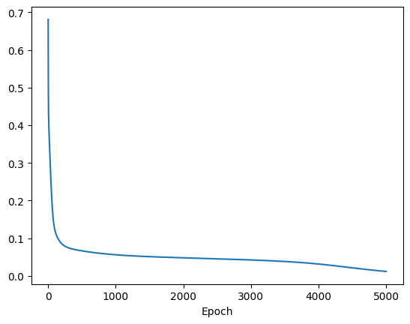
Model of sine wave
mean_squared_error
MSE:
0.005590150132775307
model = keras.Sequential([layers.Dense(units=4, input_shape=[1])])
model.add(layers.Dense(units=10,activation='tanh'))
model.add(layers.Dense(units=10,activation='tanh'))
model.add(layers.Dense(units=10,activation='tanh'))
model.add(layers.Dense(units=10,activation='tanh'))
model.add(layers.Dense(units=1))
opt = keras.optimizers.Adam(learning_rate=0.0001)
model.compile(loss='mean_squared_error', optimizer='SGD', metrics=['mean_squared_error'])
loss

Slide 3
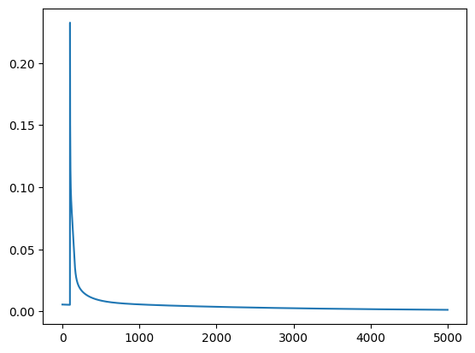
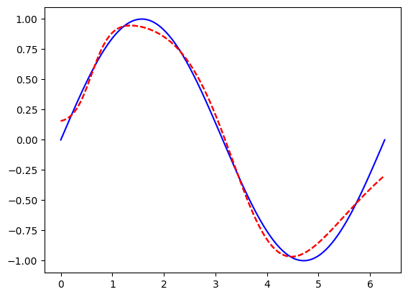
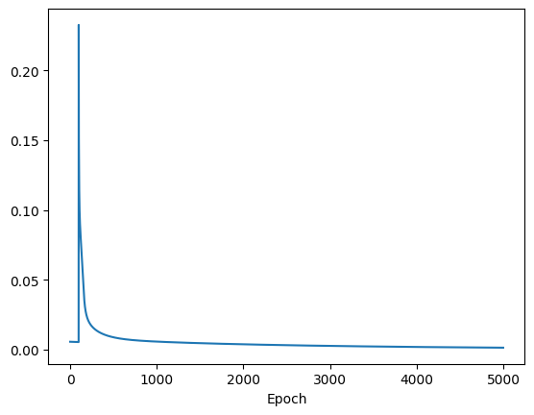
Model with Pruning
MSE:
0.0013337188865989447
batch_size=len(x)
epochs=2
num_features = x.shape[0] * 1
end_step = np.ceil(num_features / batch_size).astype(np.int32) * epochs
pruning_params = {'pruning_schedule':
tfmot.sparsity.keras.PolynomialDecay(initial_sparsity=0.0,
final_sparsity=0.9,begin_step=0,end_step=end_step)
}
pruning_schedule = tfmot.sparsity.keras.ConstantSparsity(
target_sparsity=0.3, begin_step=0, end_step=100, frequency=100
)
model_for_pruning =
tfmot.sparsity.keras.prune_low_magnitude(model,
pruning_schedule=pruning_schedule)
model_for_pruning.compile(
loss="mean_squared_error",
optimizer='SGD', metrics=['mean_squared_error']
)

Slide 4
Model with quantization

Slide 5
TF Lite
converter = tf.lite.TFLiteConverter.from_saved_model(net_save_path)
tflite_model = converter.convert()
# Saving model
with open('models/sinemodel.tflite', 'wb') as f:
f.write(tflite_model)
# xxd
# Convert to a C source file TF lite micro
!xxd -i {MODEL_TFLITE} > {MODEL_TFLITE_MICRO}
# Update variable names
REPLACE_TEXT = MODEL_TFLITE.replace('/', '_').replace('.', '_')
!sed -i 's/'{REPLACE_TEXT}'g_sine_model_data[] DATA_ALIGN_ATTRIBUTE' {MODEL_TFLITE_MICRO}

Slide 6
Renode
mach create
machine LoadPlatformDescription @/opt/renode/platforms/boards/arduino_nano_33_ble.repl
sysbus LoadELF @/home/fred/Arduino/tflitebare/build/arduino.mbed_nano.nano33ble/tflitebare.ino.elf
machine EnableProfiler @/home/fred/profiler6
sysbus.cpu EnableProfilerCollapsedStack @/home/fred/trace6 true

Slide 7
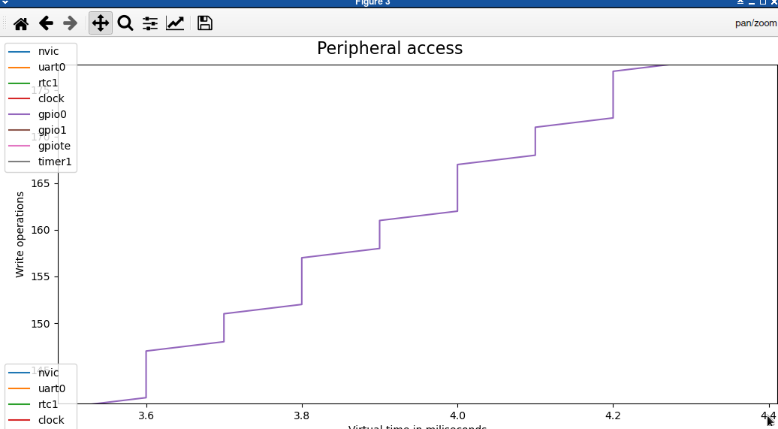
Renode
digitalWrite(D2,HIGH);
Delay(100);
digitalWrite(D2,LOW);
digitalWrite(D2,HIGH);
TfLiteStatus invoke_status = interpreter->Invoke();
digitalWrite(D2,LOW);

